Slide 1
Breast Cancer prediction model
AI project by Mansi Sharma (Reg No. - 209301198)

Slide 2
Index
Introduction
Hardware & Software requirements
Dataset & Input
Implementation
Algorithm
Accuracy
Conclusion

Slide 3

Introduction
According to the Centers for Disease Control and Prevention (CDC), around 220,000 women are diagnosed with breast cancer each year in the United States. Although not all risk factors for breast cancer are known to us, some characteristics, including family history, age, obesity, use of alcohol and tobacco, and obesity, have been identified. Breast cancer is the second leading cause of cancer death in women after lung cancer.
Patients may learn about their diagnosis too late to begin treatment if breast imaging procedures are not used. The goal of this project is to determine whether it is possible to identify the type of breast cancer (malignant or benign) from the given characteristics of a breasts’ mass as determined from digital images.

Slide 4
Hardware & Software requirements
2.4 GHz Core Processor or Core 2 DUO GPU
2 GB RAM, 8 GB ROM with additional file space
Jupyter notebook with the latest version installed
Python version 3.5 or above

Slide 5
Dataset and inputs
The characteristics of the cell nuclei have been captured in the images and a classification methods which uses linear programming to construct a decision line. The dataset is published by Kaggle and taken from the University of California Irvine (UCI) machine learning repository. The data is taken from the Breast Cancer Wisconsin Center. It includes ten (10) attributes taken from each cell nucleus as well as ID and the diagnosis (M=malignant, B=benign). The dataset has 570 cases in which 357 are benign and 212 are malignant.

Slide 6
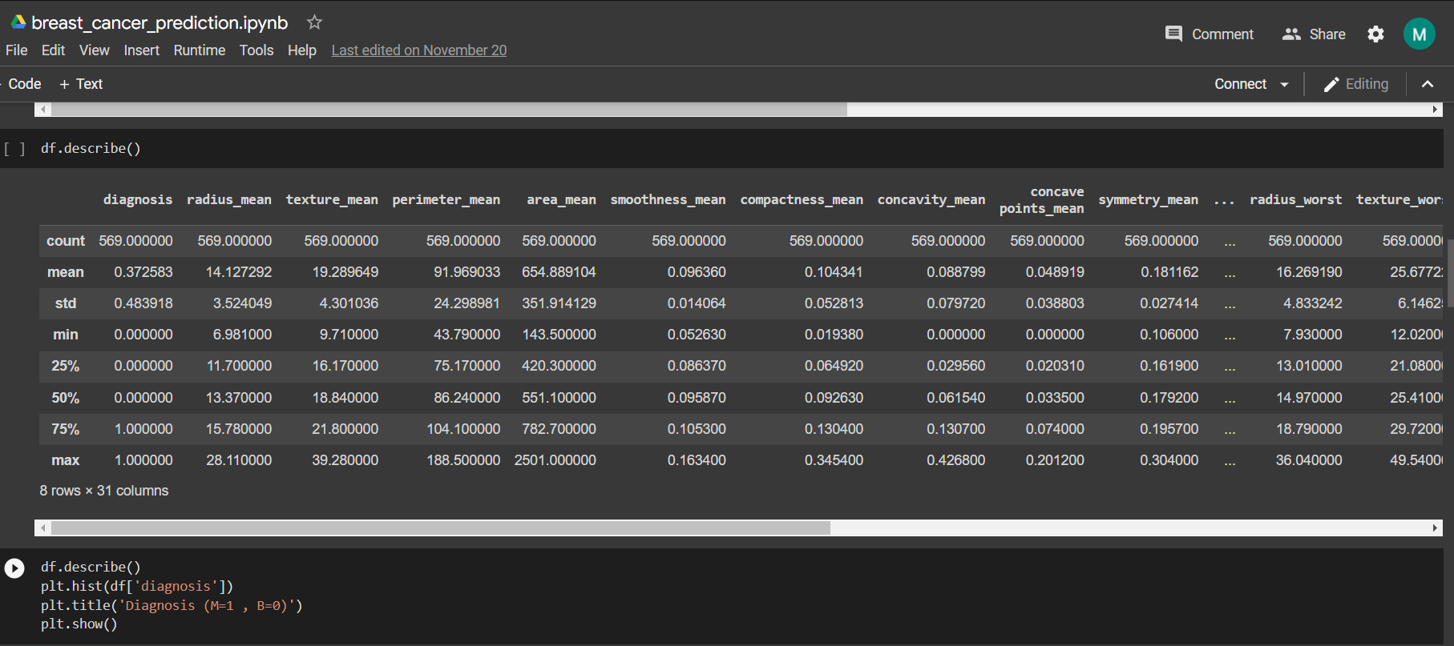
Dataset and inputs

Slide 7
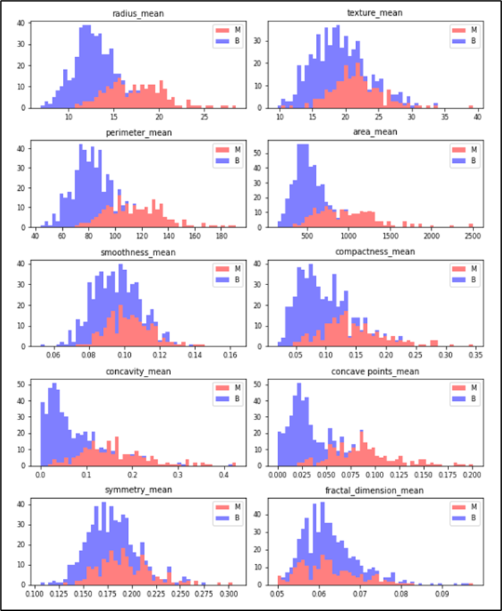
Data Visualisation

Slide 8
Implementation
After importing the necessary libraries and cleaning the data, I have plotted graphs against individual features in the dataset to determine a relation between the given mean values and classification of the disease.
A few of these mean values pointed towards a pattern like perimeter, area, compactness and concavity.
After this we split the data into 2 parts- training and testing data. Training set included 70% of the total data and remaining was kept for testing.

Slide 9
Implementation
We build a classification model for disease prediction using the features. For this, we have used KNN algorithm.
K-NN algorithm assumes the similarity between the new case/data and available cases and put the new case into the category that is most similar to the available categories.
K-NN algorithm stores all the available data and classifies a new data point based on the similarity. This means when new data appears then it can be easily classified into a well suite category by using K- NN algorithm.

Slide 10
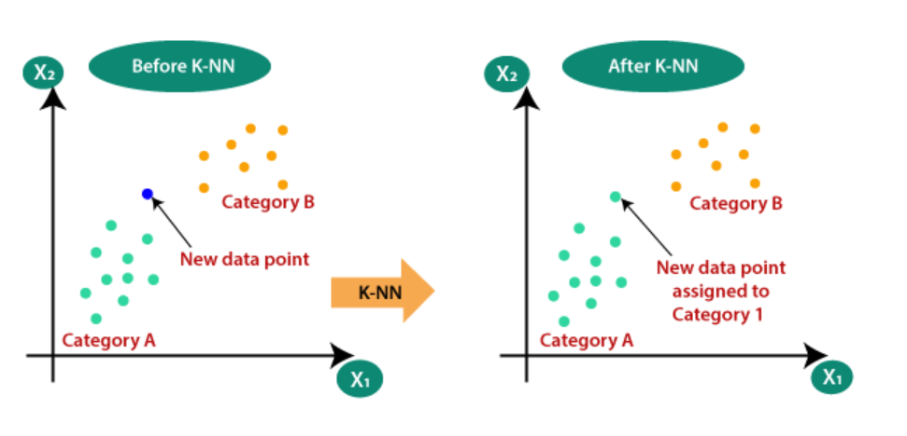
K-NN

Slide 11
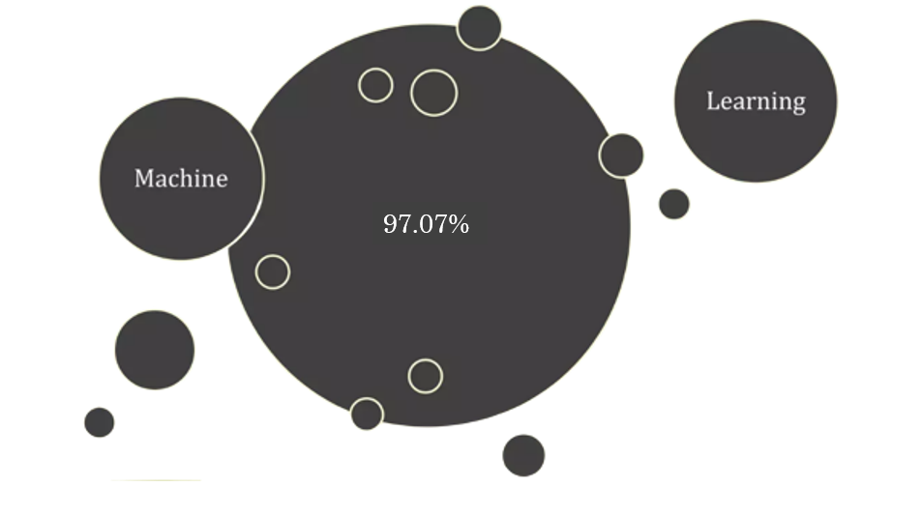
Accuracy

Slide 12
Conclusion
•This study identifies the KNN model to be successful in breast cancer classification with an accuracy rate of 97.07%
•Our results show that ML algorithms can classify breast cancer outcomes with high accuracy and identify key characteristics even for small datasets.

Slide 13
Thankyou.

